Slide 1
Detecting Endometriosis Within Laparoscopic Imaging
By Allie Wicklund

Slide 2
Table of Contents
What is Endometriosis?
GLENDA
How to Clean a Database
Google Colab
Images and their Annotations
Conclusions and Recommendations

Slide 3
What is Endometriosis?
A condition resulting from the appearance of endometrial tissue outside the uterus and causing pelvic pain

Slide 4
GLENDA
Gynecologic Laparoscopy ENdometriosis Dataset

Slide 5
GLENDA
Gynecologic Laparoscopy ENdometriosis Dataset
Alpen-Adria University in Austria

Slide 6
GLENDA
Gynecologic Laparoscopy ENdometriosis Dataset
Alpen-Adria University in Austria
25,683 images of laparoscopic surgery (521 annotations)

Slide 7
How to Clean a Database

Slide 8
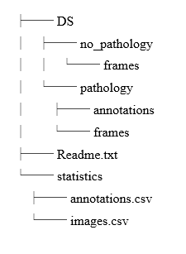
How to Clean a Database

Slide 9
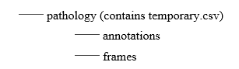
How to Clean a Database

Slide 10
Google Colab

Slide 11
Google Colab
Powerful cloud-based computing software

Slide 12
Google Colab
Powerful cloud-based computing software
Can train models “quickly”

Slide 13
Google Colab
Powerful cloud-based computing software
Can train models “quickly”
Randomly will quit runtime, even to paid users

Slide 14
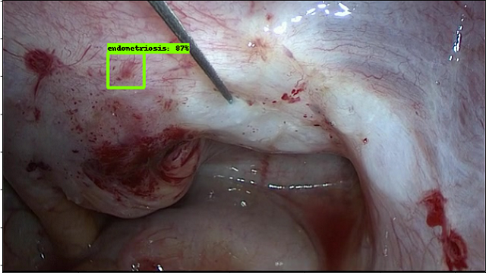

Slide 15
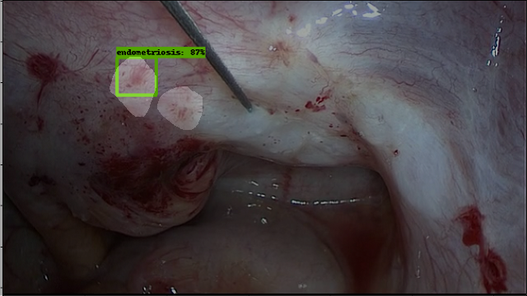

Slide 16
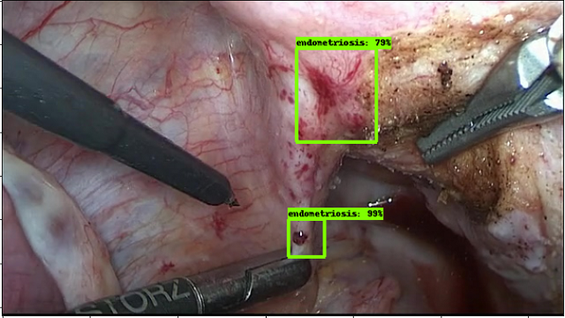

Slide 17
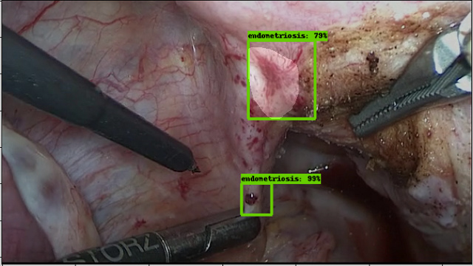

Slide 18
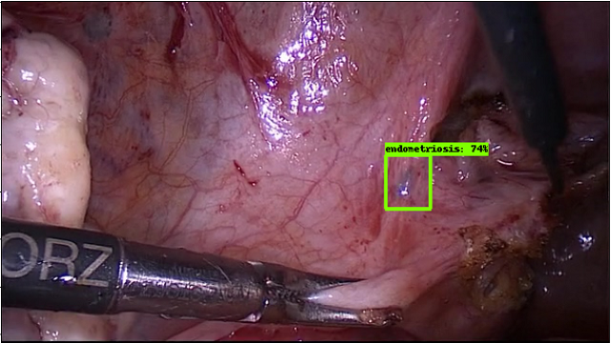

Slide 19
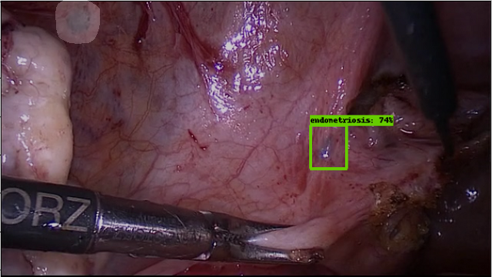

Slide 20
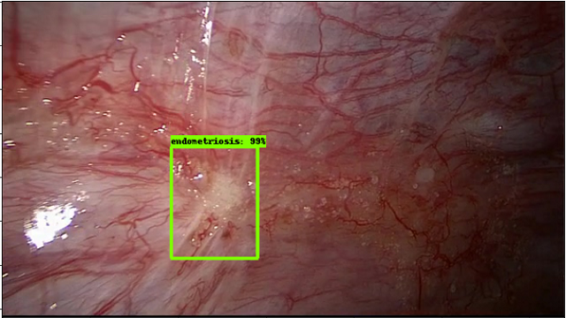

Slide 21
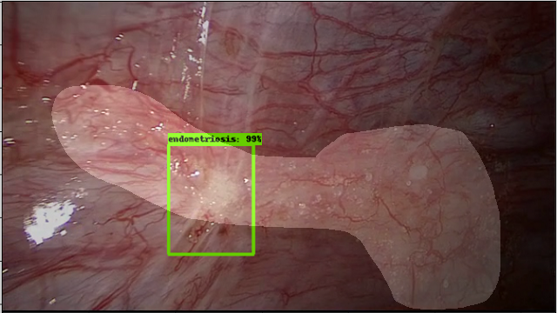

Slide 22
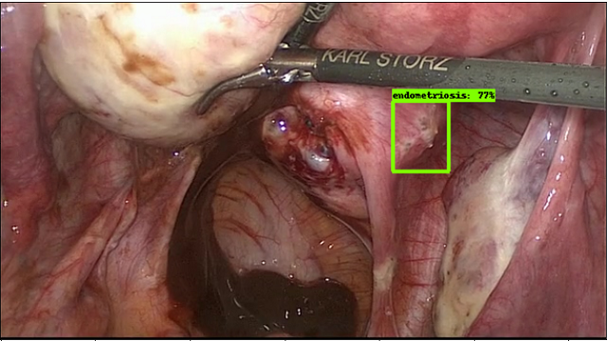

Slide 23
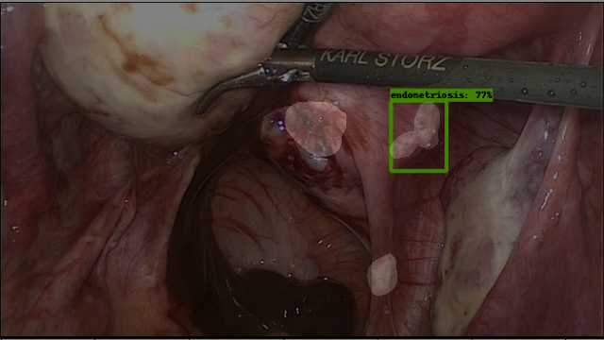

Slide 24
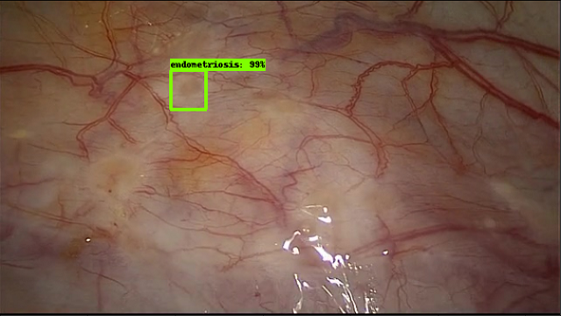

Slide 25
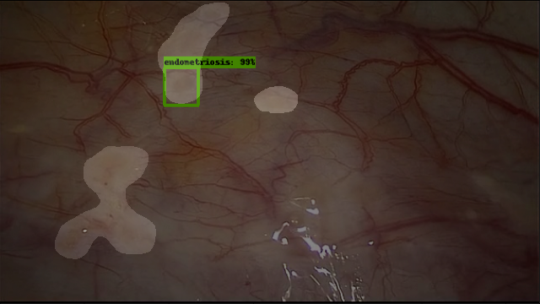

Slide 26
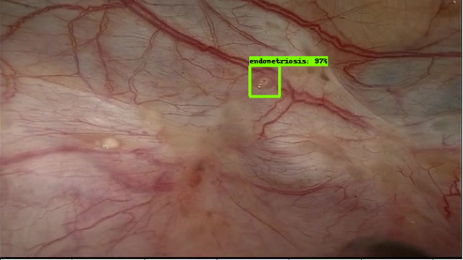

Slide 27
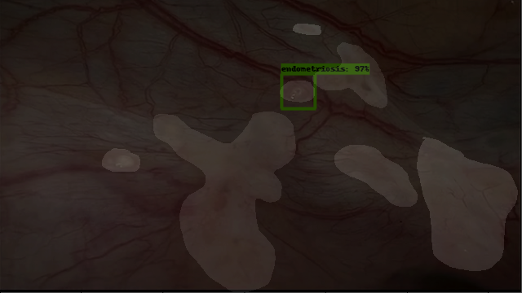

Slide 28
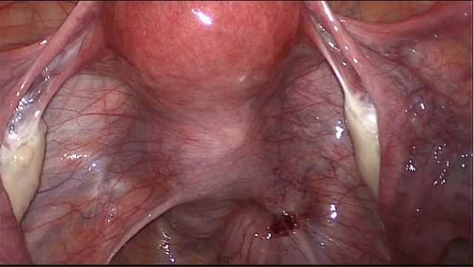

Slide 29
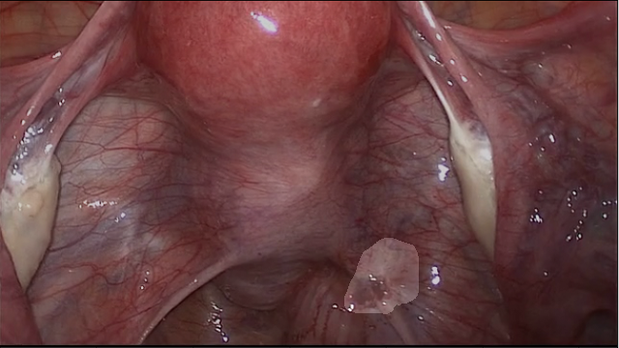

Slide 30
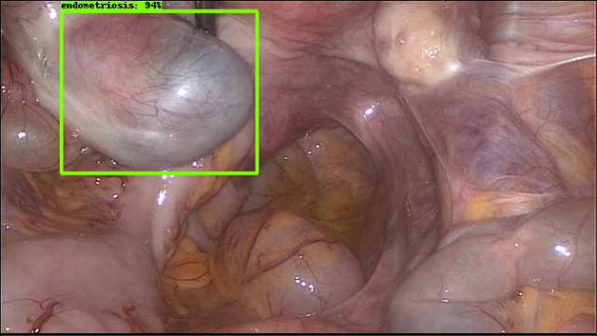

Slide 31
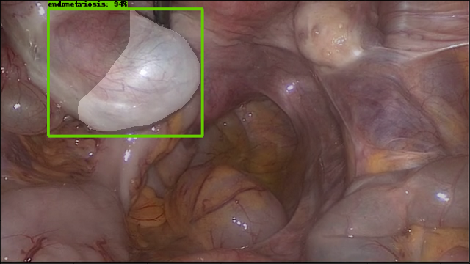

Slide 32
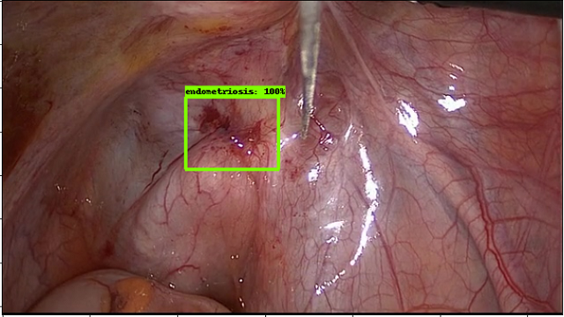

Slide 33
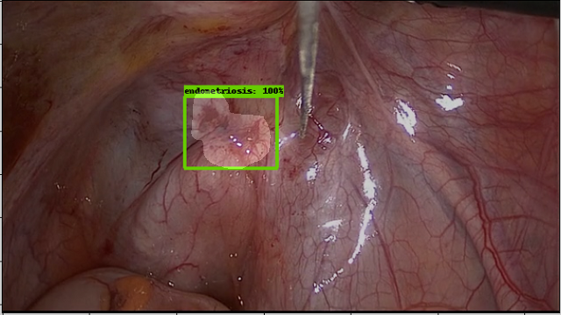

Slide 34
Conclusions and Recommendations

Slide 35
Conclusions and Recommendations
More images

Slide 36
Conclusions and Recommendations
More Images
Hyperparameter Tuning

Slide 37
Conclusions and Recommendations
More Images
Hyperparameter Tuning
Update to video on a scope

